Slide 1
INSURANCE ANALYSIS
GROUP
4
NAME:
Ronit Raikar
Sumesh Shinde
Ambika Malaji
Linalin Nayak

Slide 2
OVERVIEW
Analyzed insurance- domain to enhance decision-making.
Branch dashboard to discuss New and renewal business numbers with each branch.

Slide 3
PROCESS
Data Understanding
Data Cleaning
Data Modelling
Data Analysis
Insights

Slide 4
KPIS
Number of Invoices by Account Executive
Yearly Meeting Count
Cross Sell, New, Renewal
  Cross Sell - Target, Achieve, New
  New - Target, Achieve, New
  Renewal - Target, Achieve, New
Stage Funnel by Revenue
Number of Meetings by Account Executive
Top Open Opportunity

Slide 5
OBJECTIVES
Easy-to-understand visualizations
Create clear charts and graphs to tackle the KPIs
Make better-informed decisions

Slide 6
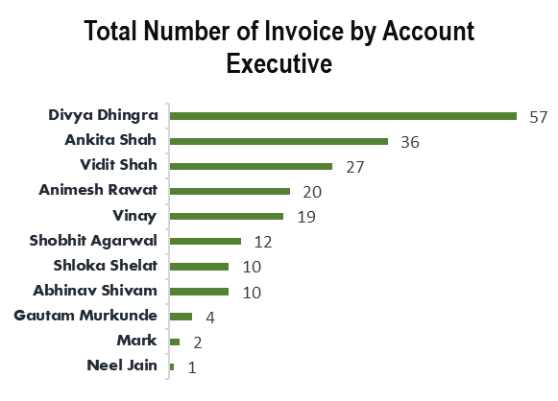
Number of Invoices by Account Executive
This metric tracks the total number of invoices generated by each account executive.
It provides insights into individual performance and helps identify top-performing executives.

Slide 7
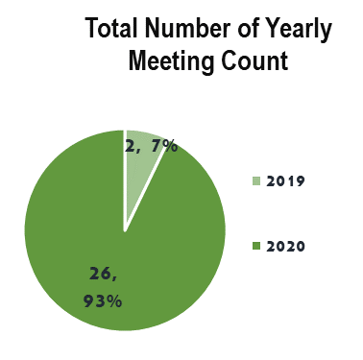
Yearly Meeting Count
This KPI measures the total number of meetings conducted by account executives over a year.
It reflects engagement, communication, and relationship-building efforts.
By tracking meeting counts, organizations can assess the effectiveness of their sales and client management strategies

Slide 8
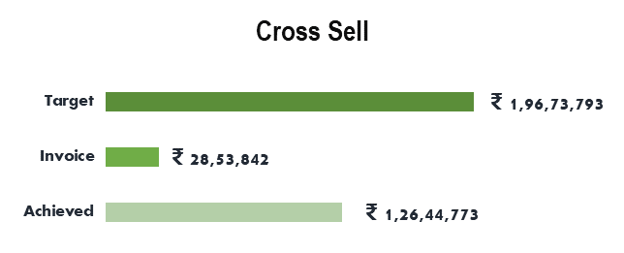
Cross Sell - Target, Achieve, New
The Cross Sell–Target, Achieve, New is a key performance indicator used in the insurance industry.
Cross-Sell Business:
  Target: The desired number of cross-selling opportunities.
  Achievement: The actual number of cross-selling opportunities achieved.
  New: Refers to new business generated through cross-selling efforts.

Slide 9
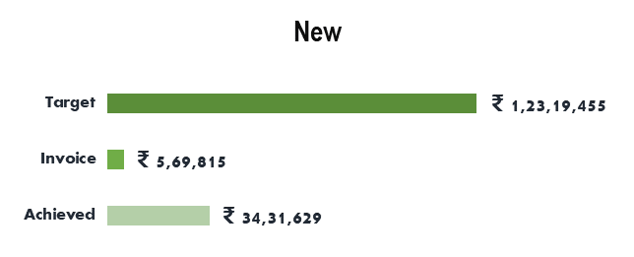
New - Target, Achieve, New
New Business:
  Target: The desired number of new-selling opportunities.
  Achievement: The actual number of new-selling opportunities achieved.
  New: Refers to new business generated through new-selling efforts.

Slide 10
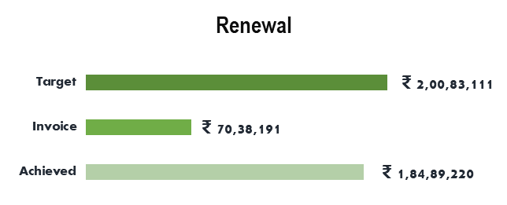
Renewal - Target, Achieve, New
Renewal Business:
  Target: The goal for renewing existing policies.
  Achievement: The actual number of renewals achieved.
  New: Indicates new business generated from renewals.

Slide 11
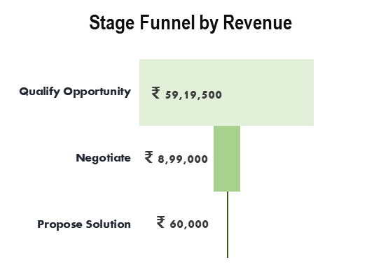
Stage Funnel by Revenue
The "Stage Funnel by Revenue" chart visually represents the revenue generated at different stages of a sales process.
This funnel illustrates the diminishing revenue as opportunities advance through the sales stages, highlighting potential areas for improvement in converting opportunities to revenue.

Slide 12
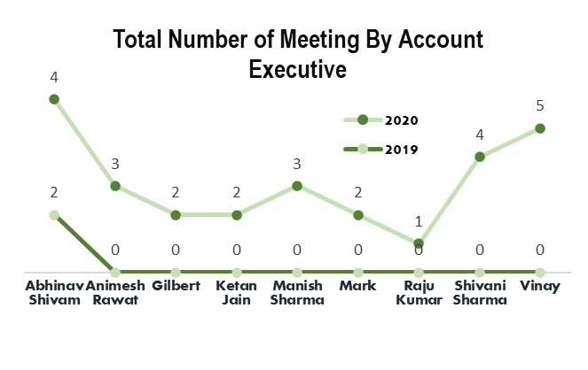
Number of Meetings by Account Executive
The "Total Number of Meetings by Account Executive" chart displays a comparative analysis of the meetings held by each account executive in 2019 and 2020.

Slide 13
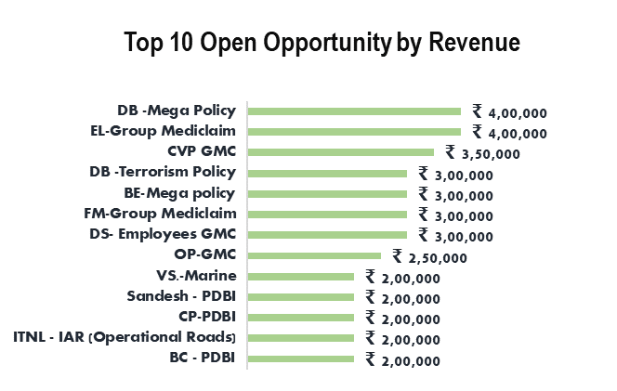
Top Open Opportunity
The "Top 10 Open Opportunity by Revenue" chart showcases the leading revenue-generating opportunities.

Slide 14
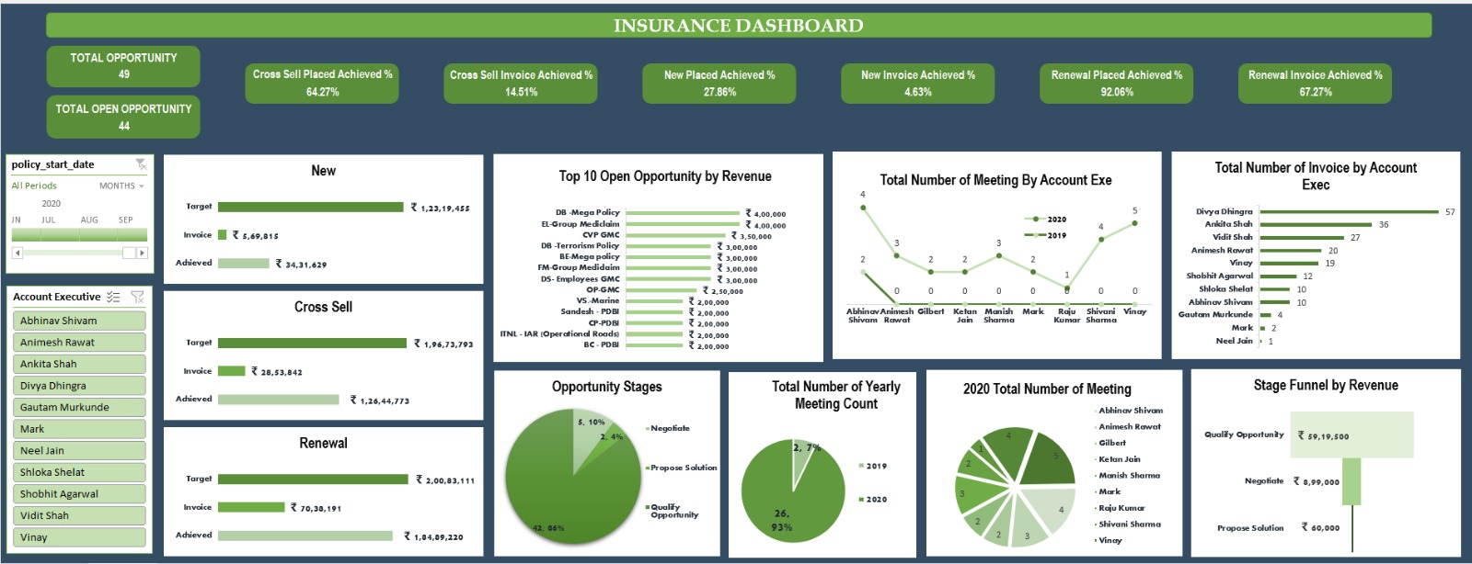
EXCEL DASHBOARD

Slide 15
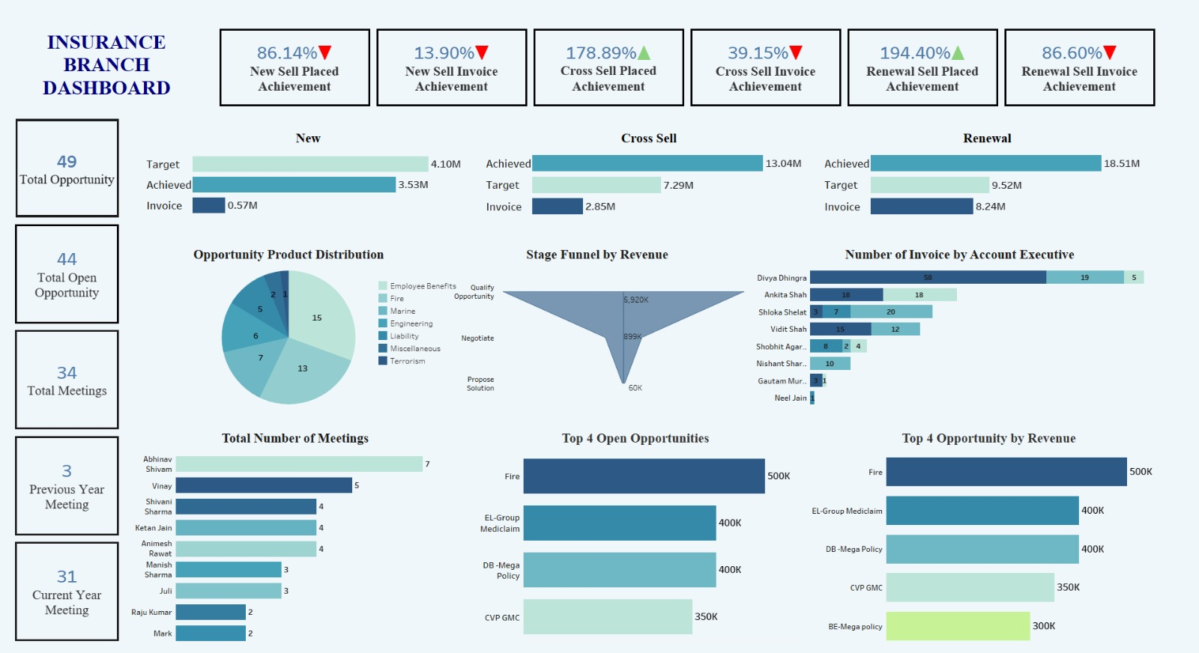
TABLEAU DASHBOARD

Slide 16
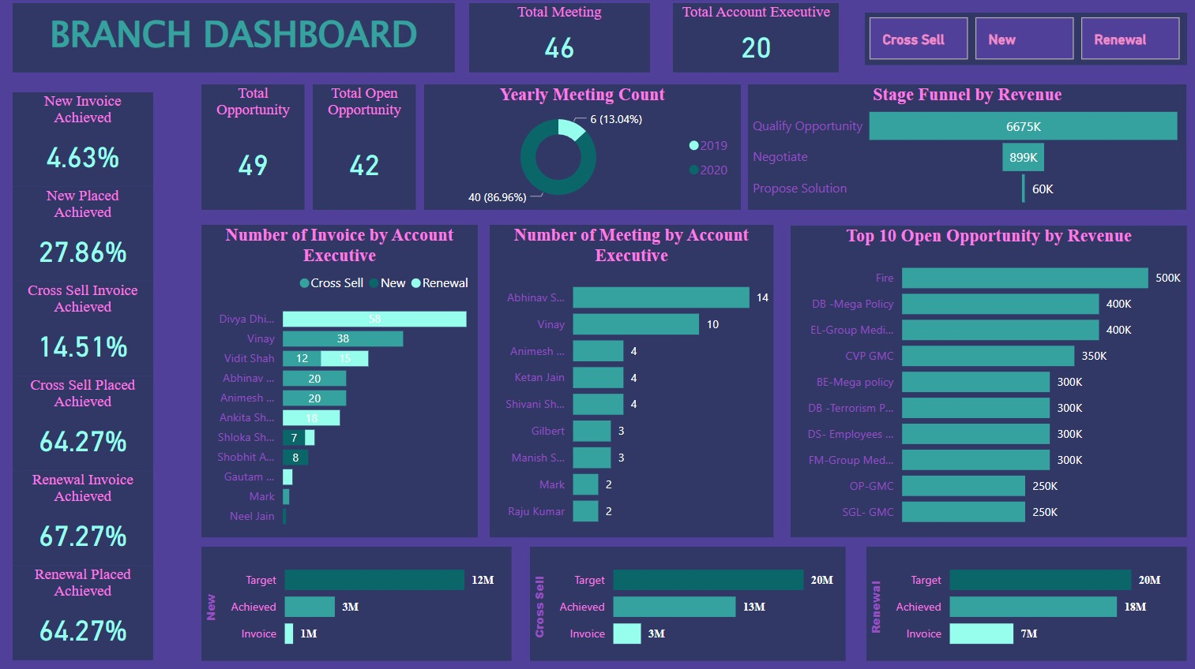
POWER-BI DASHBOARD

Slide 17
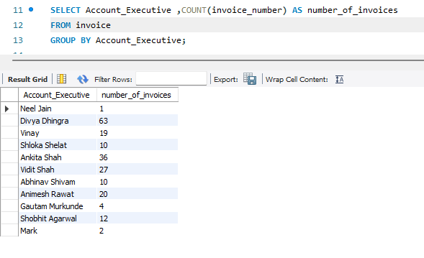
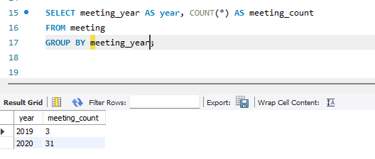
SQL
KPI 1
KPI 2

Slide 18
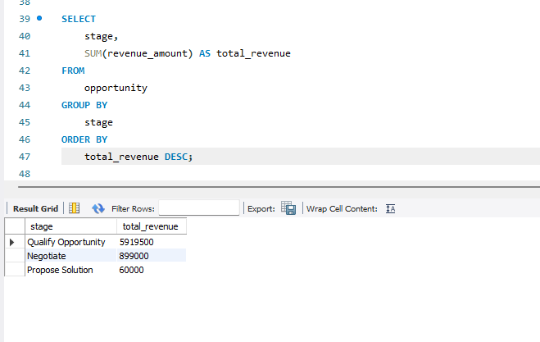
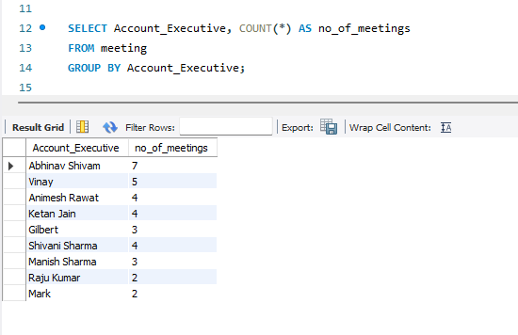
SQL
KPI 4
KPI 5

Slide 19
INSIGHTS
Business performance across different branches
Identify performance gaps by comparing targets with actual achievements
Areas where branches are underperforming
Improvement of sales strategies
Analysis of new business, cross-sell, and renewal rates
Effectiveness of current strategies

Slide 20
THANK YOU

